Slide 1

Aircraft Risk Analysis for Business Expansion
Identifying Low-Risk Aircraft for Commercial & Private Operations
By: Brenda Chepkemoi

Slide 2
Overview
The company is expanding to new industry to diversify its portfolio
The company is interested in commercial an private enterprises
The goal is to provide actionable, data-driven recommendations to minimize both life-safety and capital expenditure risks.

Slide 3

Business Understanding
Objective
Minimize the risk of accidents through data-driven aircraft selection, ensuring operational safety and compliance with industry standards.
Stakeholders:
Decision-makers in the aviation industry.

Slide 4

Data Understanding
Description of dataset
The dataset has:
  82,474 rows (entries)
  31 columns, including:
  6 float variables
  26 object data types
Source of data: National Transportation Safety Board that includes aviation accident data from 1962 to 2023

Slide 5

Data Preparation
Cleaned relevant columns to my analysis which included:
  Make and Model
  Injury columns(Total fatal injuries, minor injories,serious injuries and uninjured)
  Engine type and number
  Time

Slide 6

Data Analysis and Visualization

Slide 7
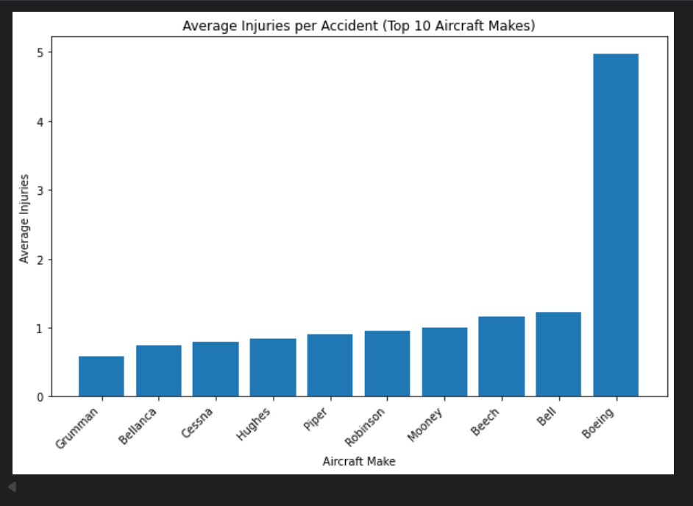
Average Injuries By Accidents by Top 10 Make

Slide 8
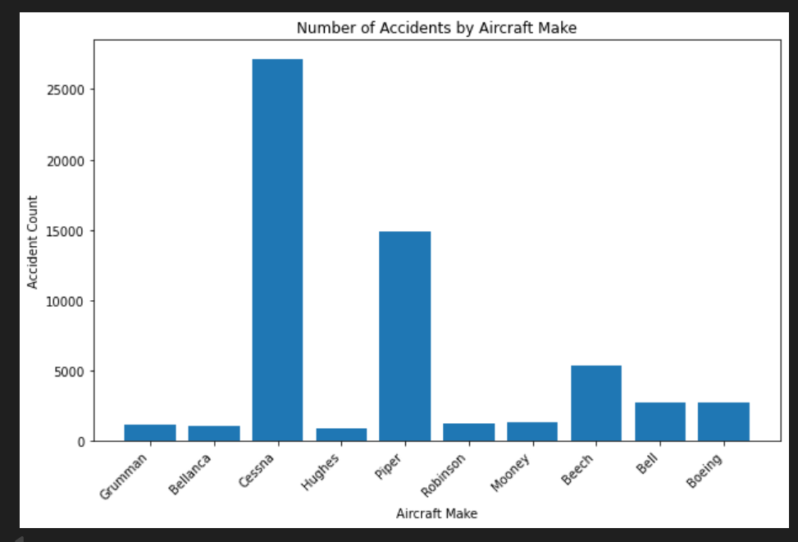
Number of Accidents by Aircraft Make

Slide 9
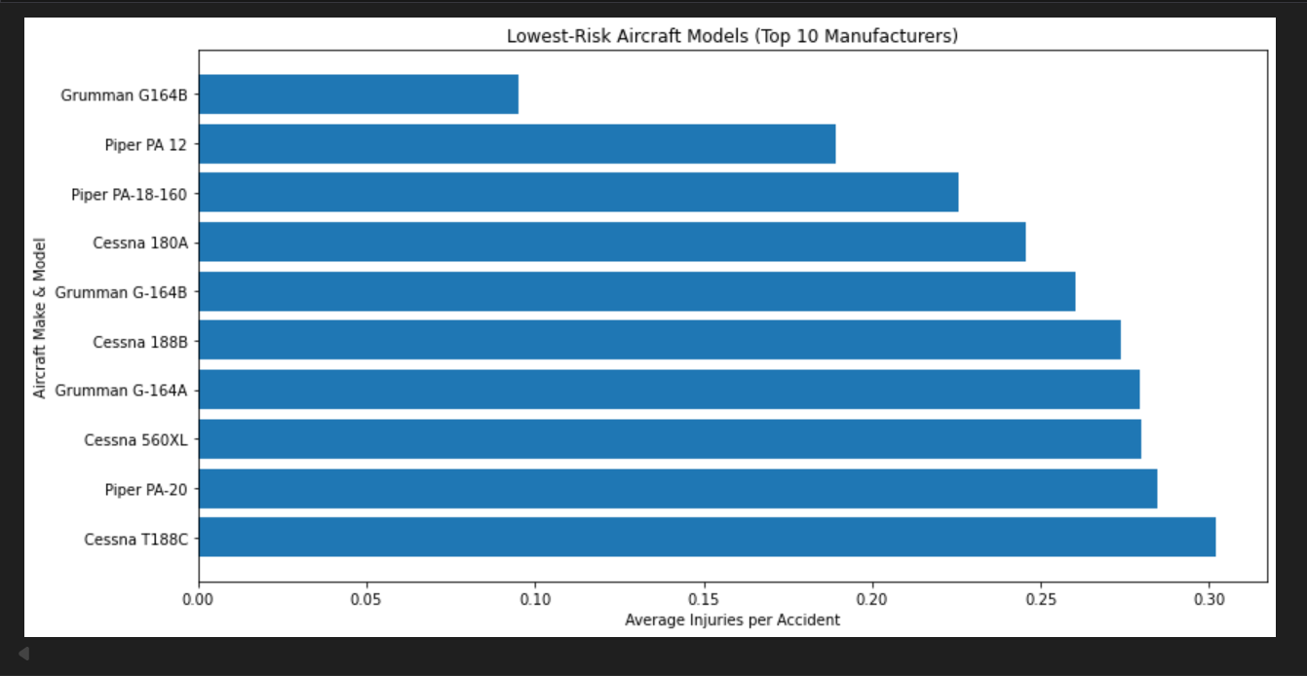
Low Risk Aircraft Model by top10 Manufacturers

Slide 10
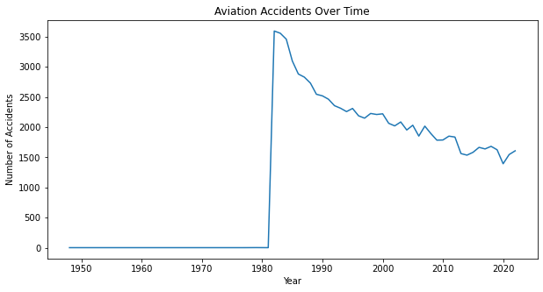
Trend Analysis over Time
From 1981 it started dropping teadily to 2020 which suggests number of accidents reduces over time.

Slide 11
Recommendations
Focus on aircraft from manufacturers such as Grumman, Bellanca, Hughes, and select Cessna and Piper models, which consistently show lower average injuries per accident.
Choose aircraft models that are recent has they have low injury rate as trend shows decreasing accidents over time.
In aircraft category, airplanes, balloons and helicopters are considered.

